Slide 1

Removal of Motion Artifacts from Photoplethysmogram Data
By: Supervisor:
Salaar Ali Assad - 21100087 Dr. Muhammad Tahir
Sheraz Hassan - 21100285
Mohammad Afaq - 21100214
Department of Electrical Engineering
Lahore University of Management Sciences

Slide 2
Recap – SPROJ 1

Slide 3
Motivation
19% of the Pakistani population suffers from Cardiovascular Diseases (CVDs), making it the leading non-communicable disease in the country [1]
Increasing demand for Electrocardiogram (ECG) which are uncomfortable, expensive, limited and require medical supervision [2]
Wrist worn Photoplethysmogram (PPG) devices offer a simpler, cheaper and more comfortable alternative

Slide 4
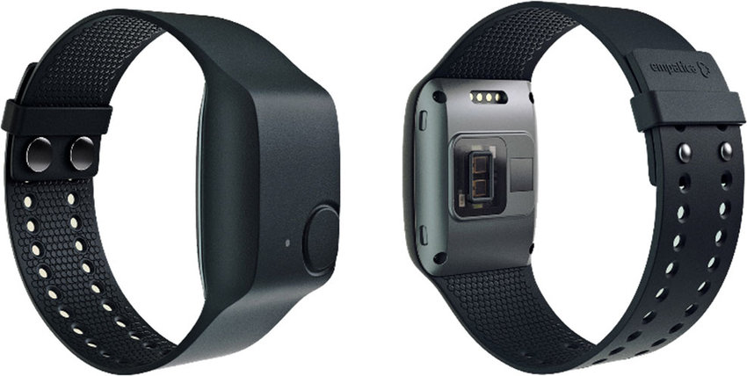
High-End Device
Empatica E4
4 LED’s and 2 photodiodes
PPG sensor (64HZ)
3-axis accelerometer (32Hz)
Temperature sensor
Pre-processing algorithm
Front and Back View of the Empatica E4

Slide 5
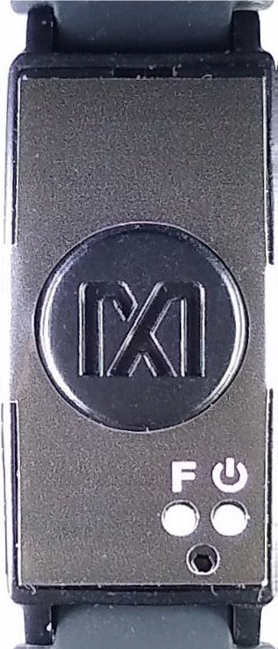
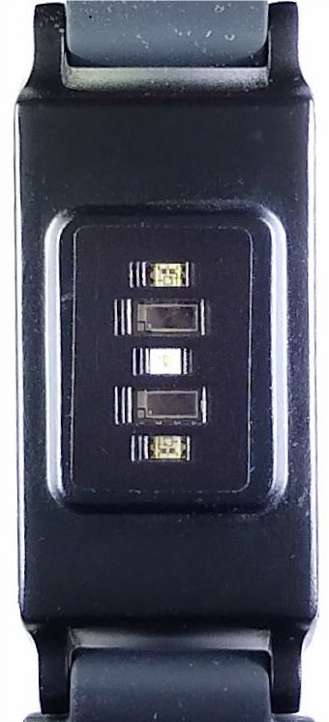
Low-End Device
Maxim MAXREFDES103#
2 LED’s and 2 photodiodes
IR emitter
Variable sampling rate
Front and Back View of the Maxim MAXREFDES103

Slide 6
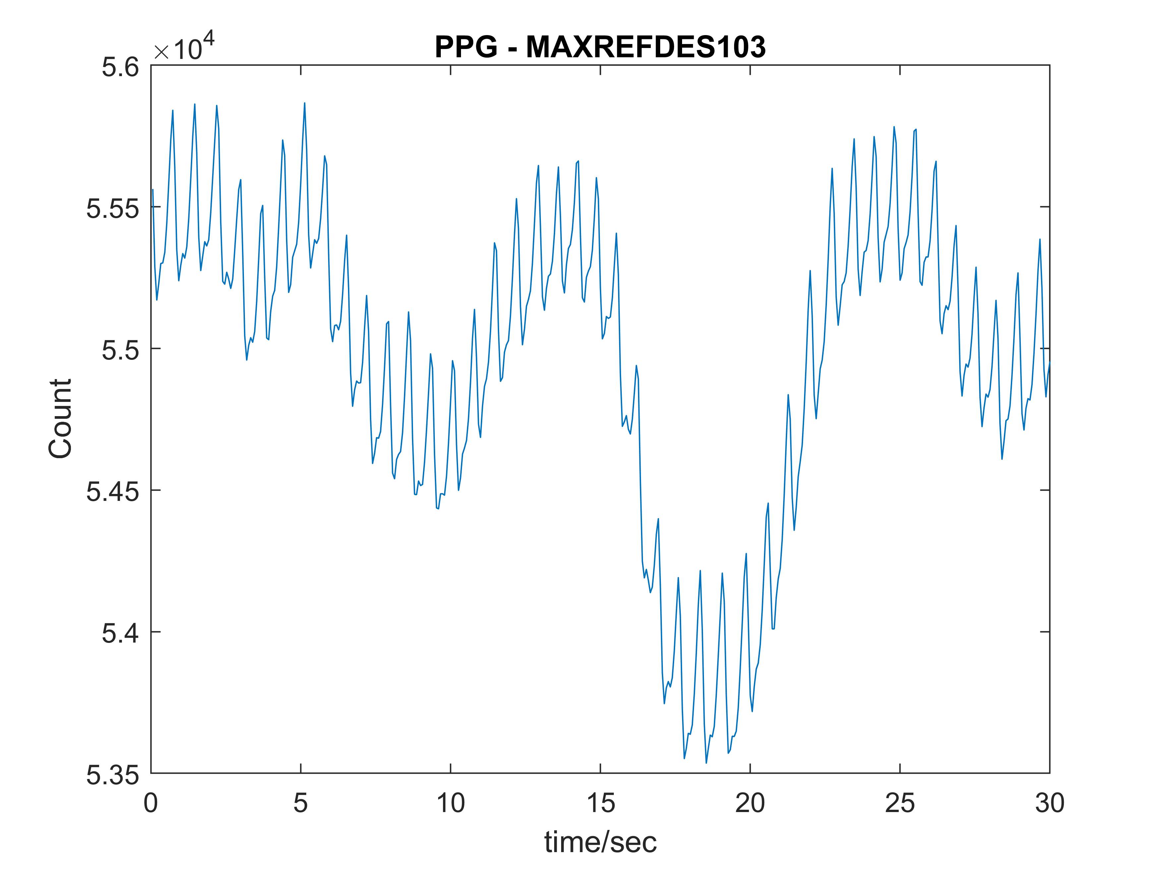
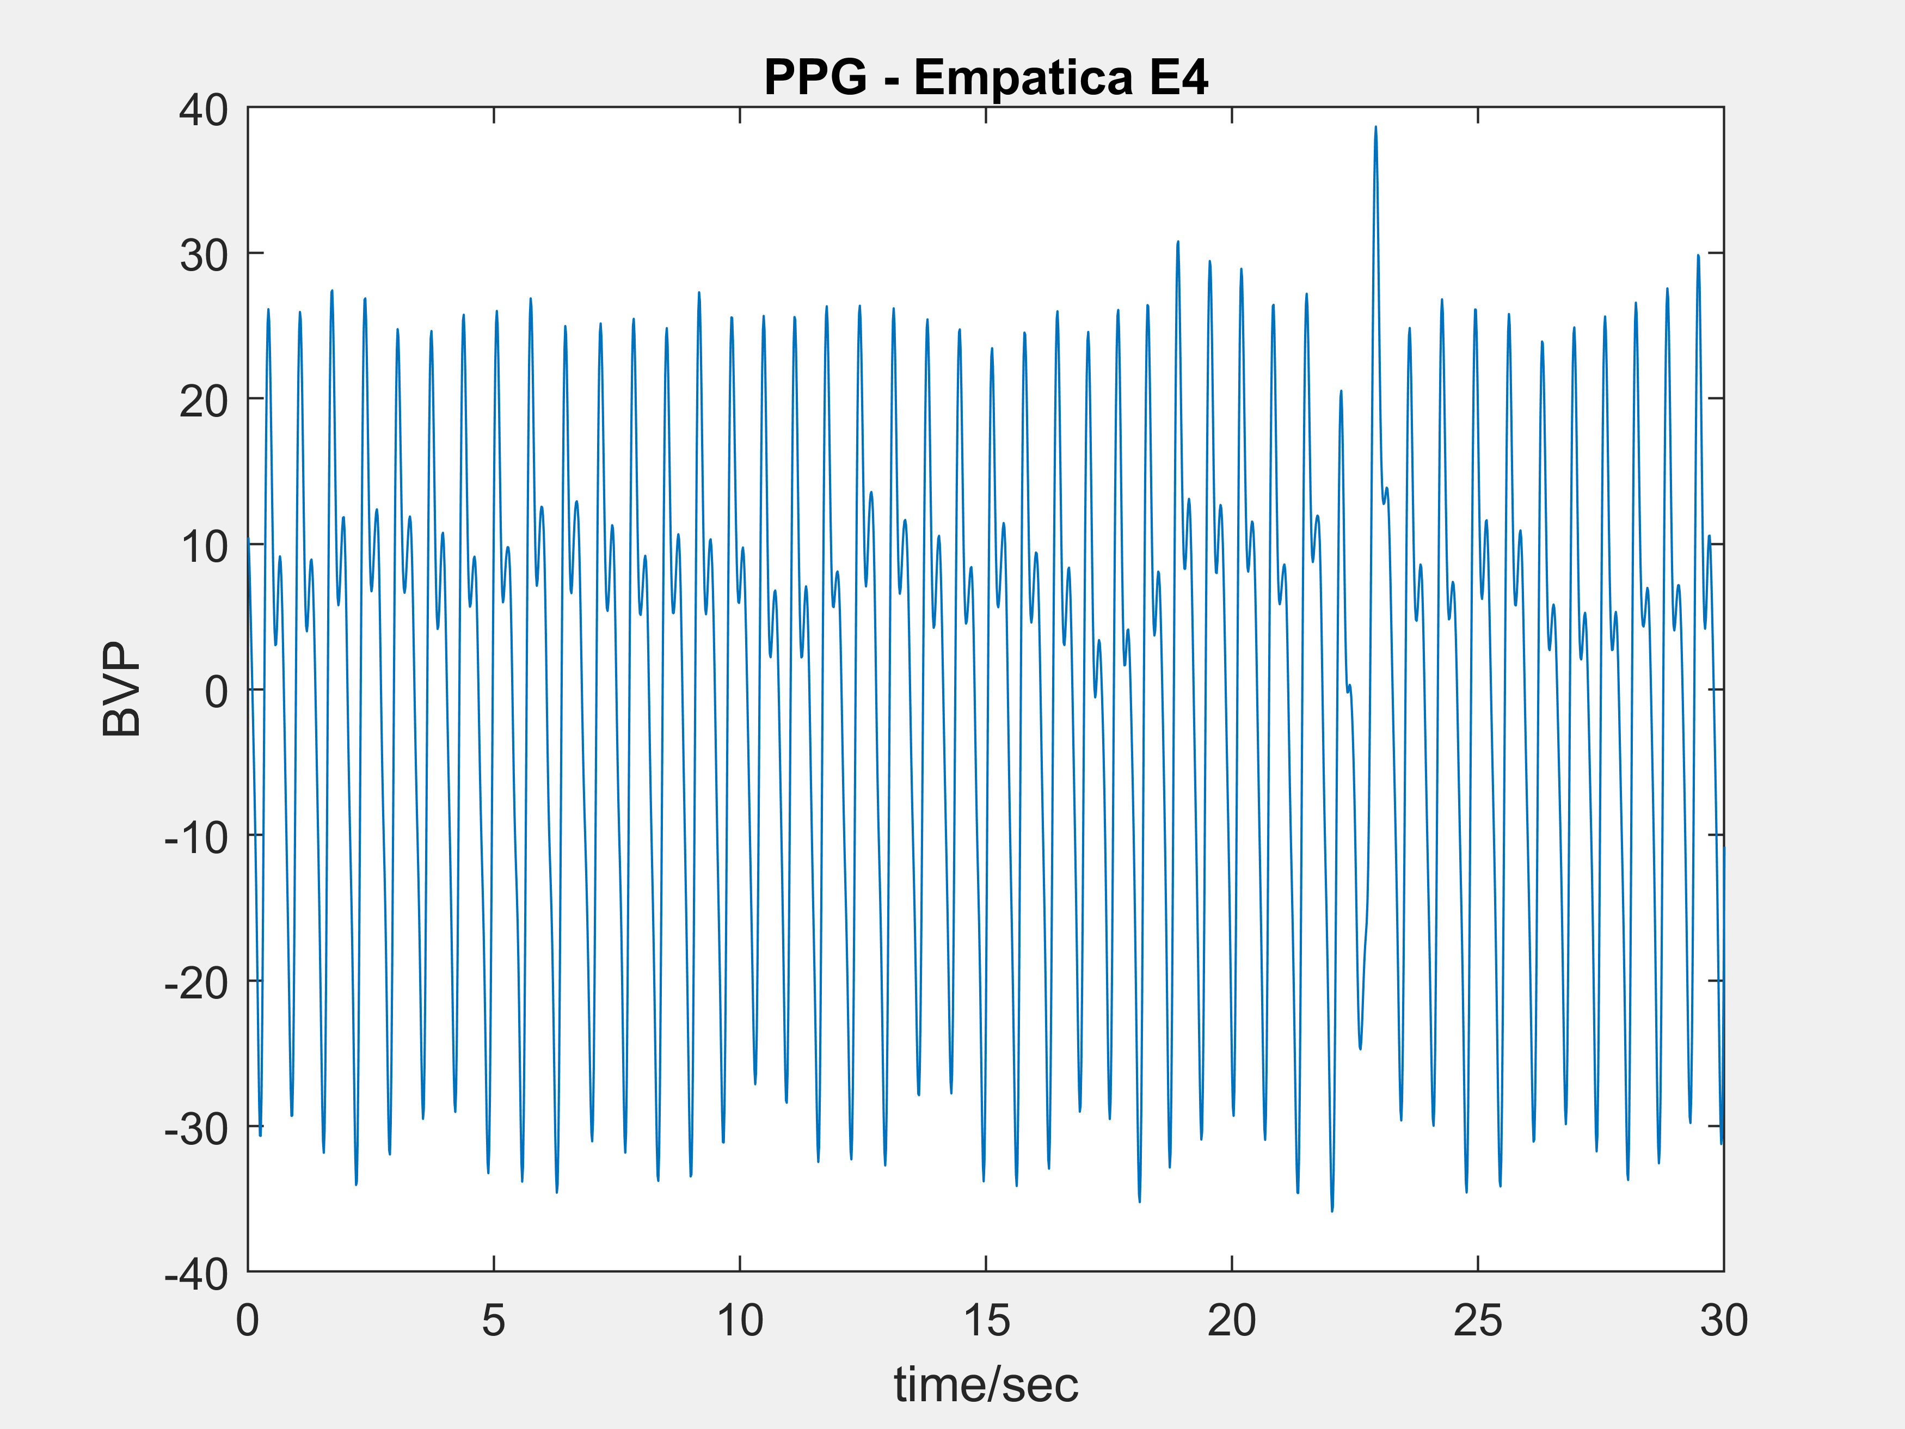
Low-end vs High-end
E4 Signal = PPG waveform + noise (1)
MAXREFDES103 Signal = Perfusion waveform + PPG waveform + noise (2)
6

Slide 7
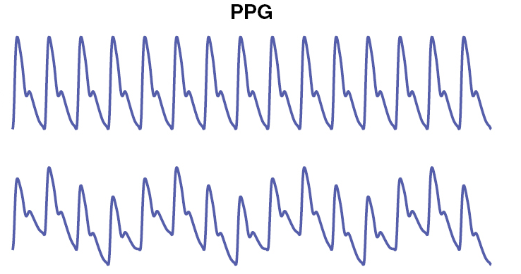
Perfusion
Variation of blood flow volume in capillary network
Causes a baseline shift in the raw PPG signal.
PPG Signal without perfusion (top) and with perfusion (bottom) [4]

Slide 8
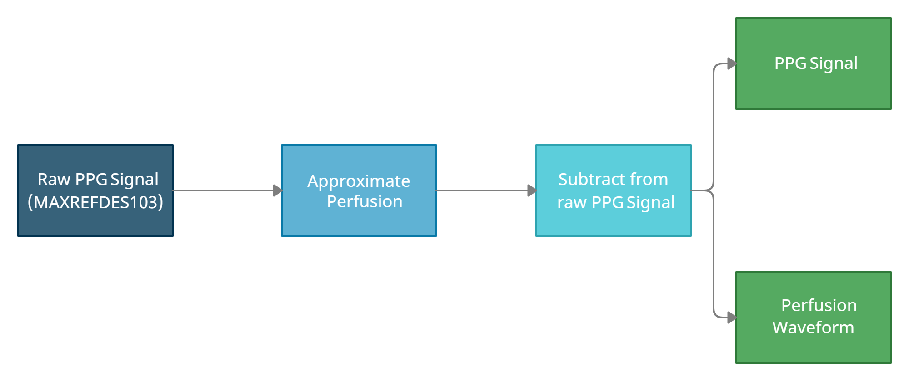
Perfusion – Removal

Slide 9
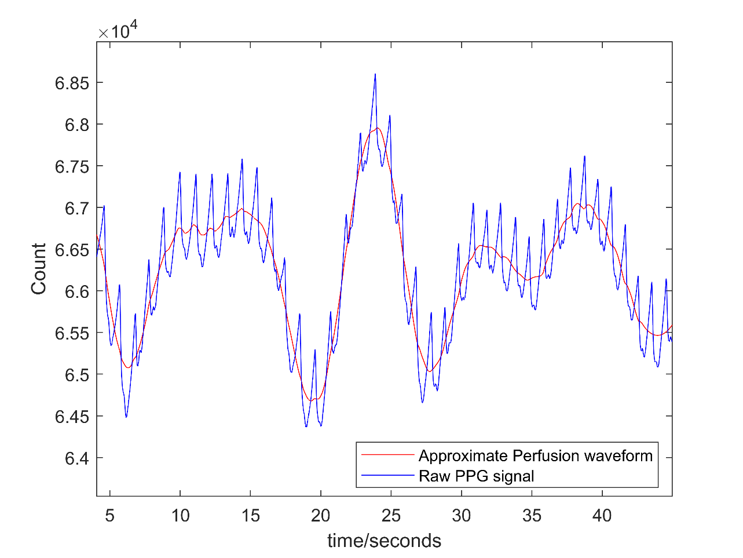
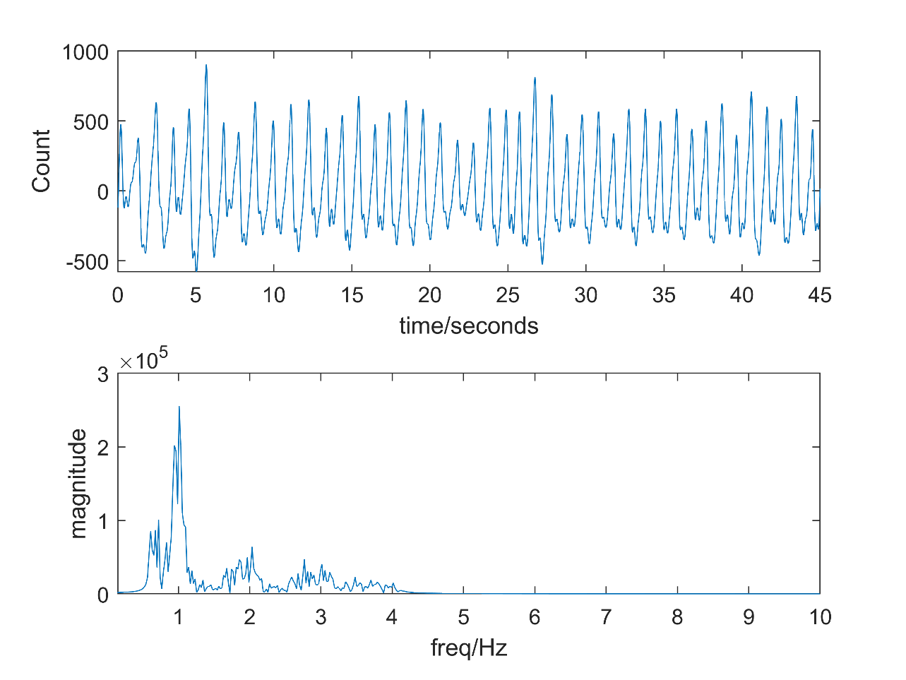
Raw PPG Signal (Blue) along with the approximated Perfusion Waveform (Red)
PPG Waveform obtained along with its Frequency Plot
9

Slide 10
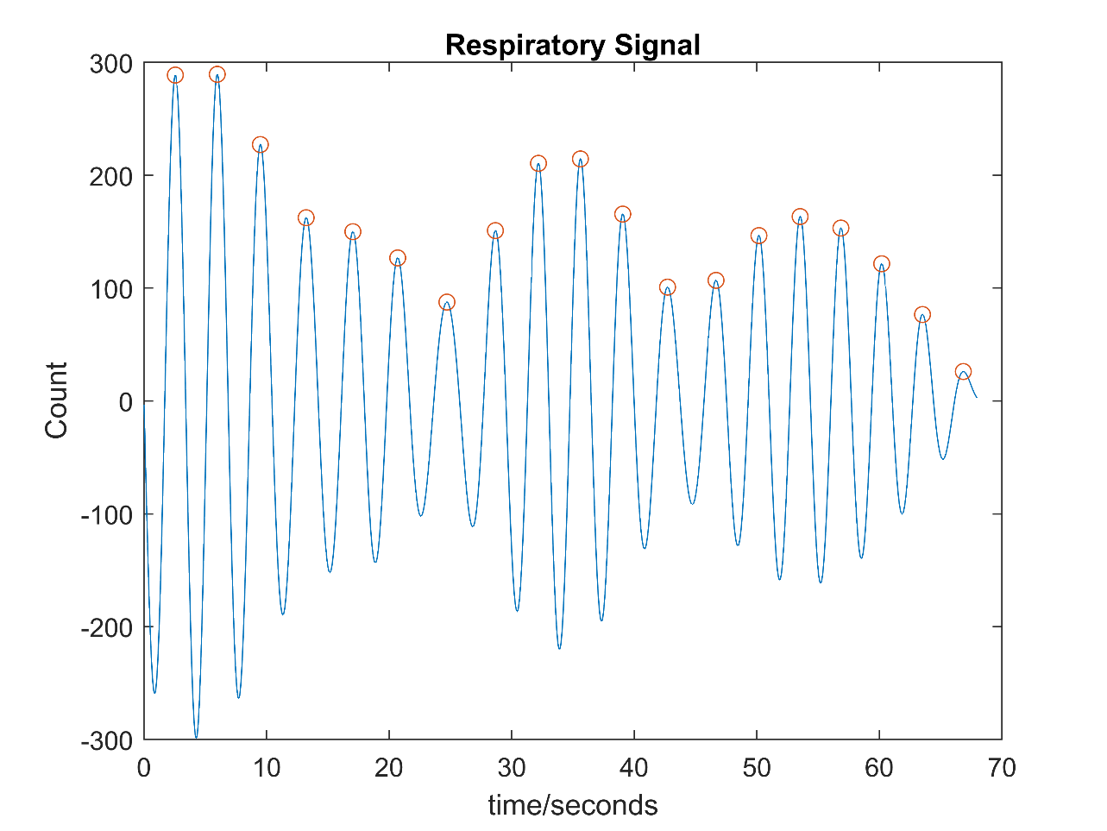
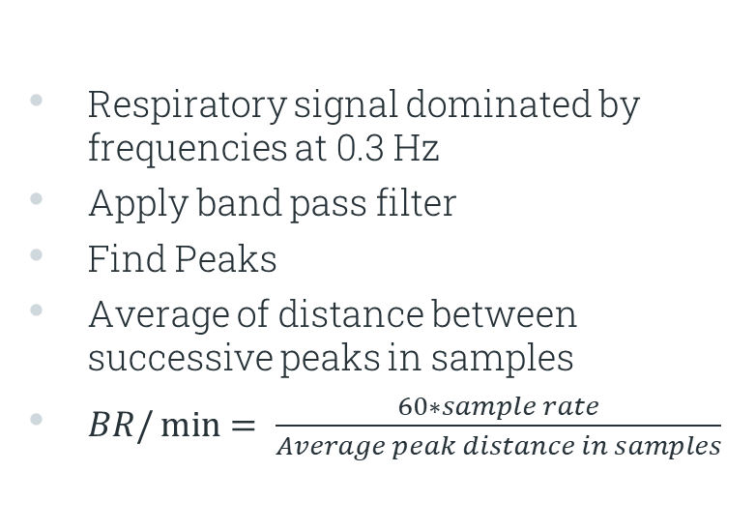
Breath Rate
Respiratory signal dominated by frequencies at 0.3 Hz
Apply band pass filter
Find Peaks
Average of distance between successive peaks in samples
$BR/\min{= \frac{60∗sample rate}{Average peak distance in samples}}$

Slide 11
SPROJ 2

Slide 12
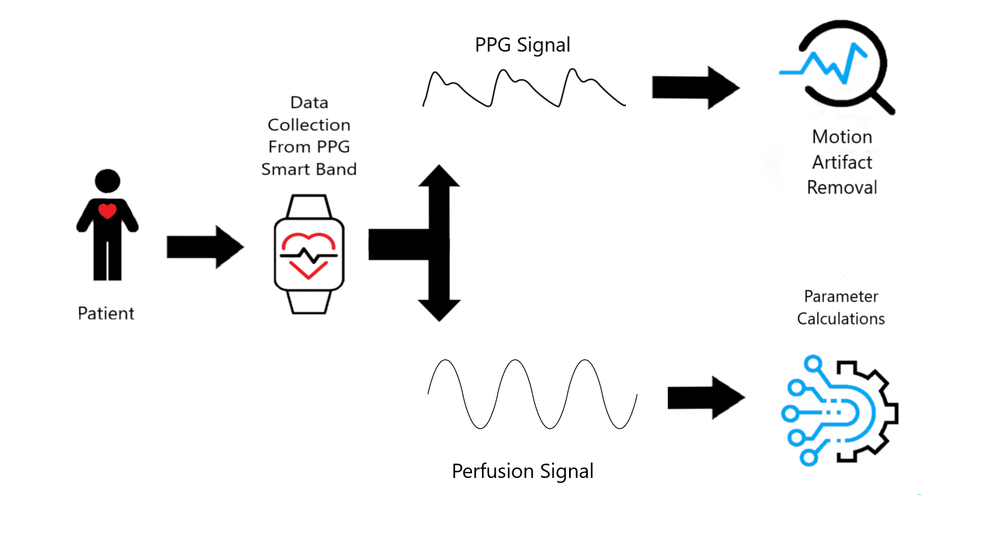
Block Diagram

Slide 13
Data Collection

Slide 14
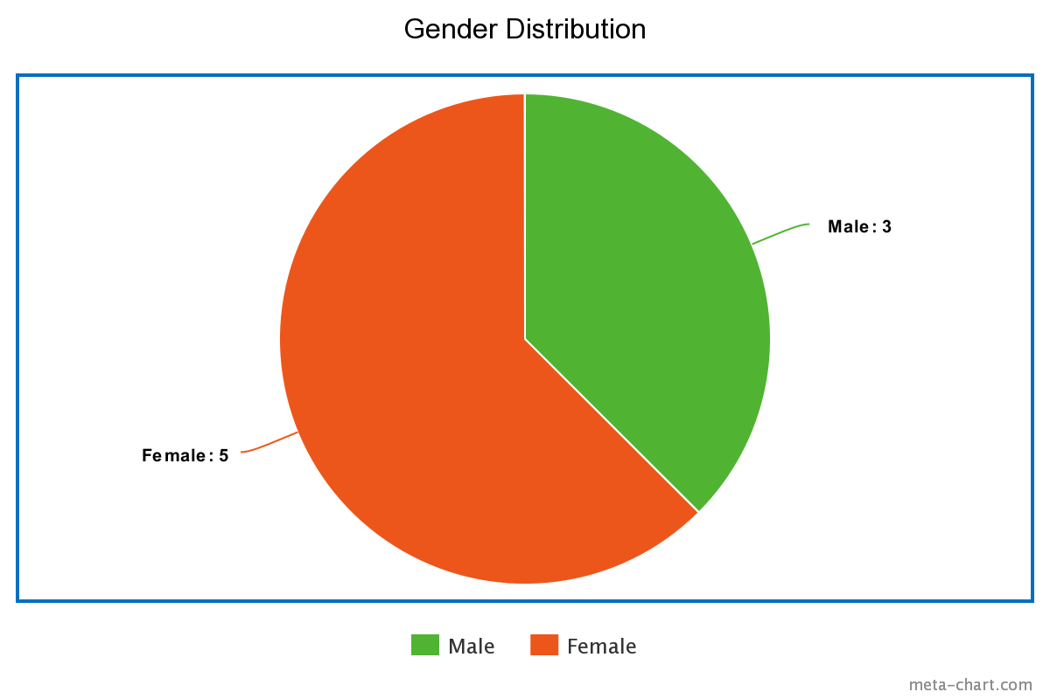
Classification
Rest position
Walking
Slight Arm Movement – Dominant
Slight Arm Movement – Non-Dominant
Typing
Writing
* Data not taken under clinical standards

Slide 15
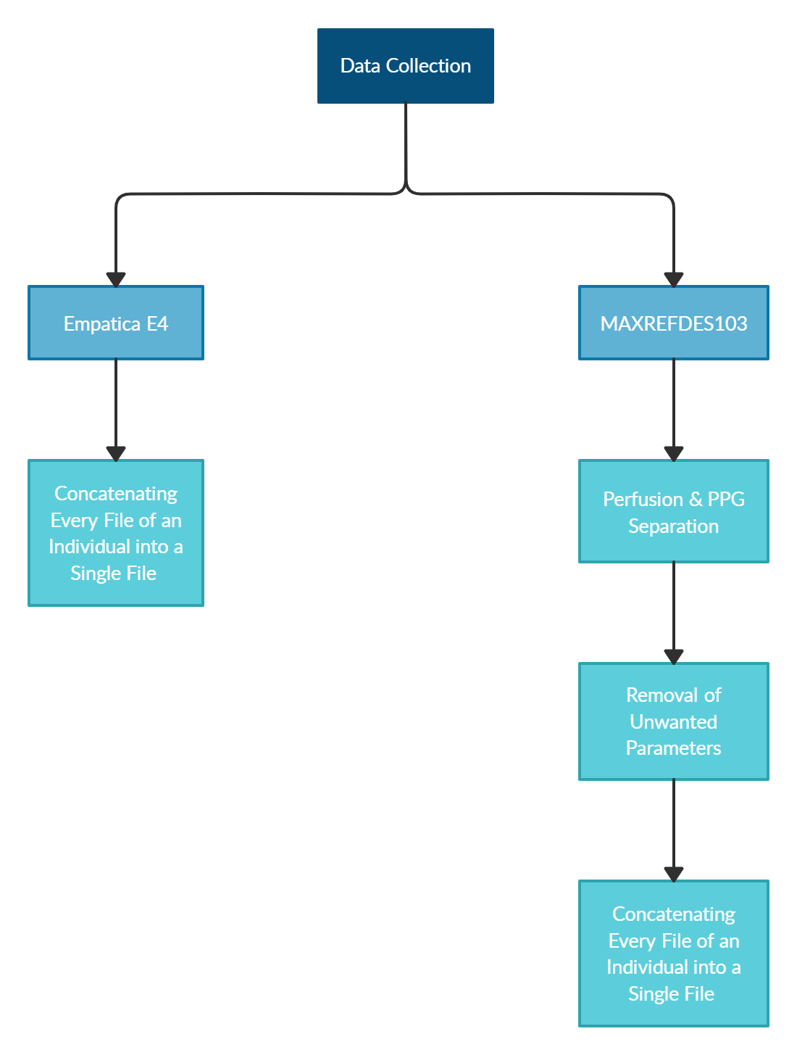

Slide 16
Motion Artifact Removal

Slide 17
Existing Methods
Independent Component Analysis (ICA)
Adaptive Filtering with Accelerometer Signal
Deep Learning

Slide 18
Attempted Approaches
Adaptive Filtering with Accelerometer Signal
Time Delay Neural Network
Weiner Filtering

Slide 19
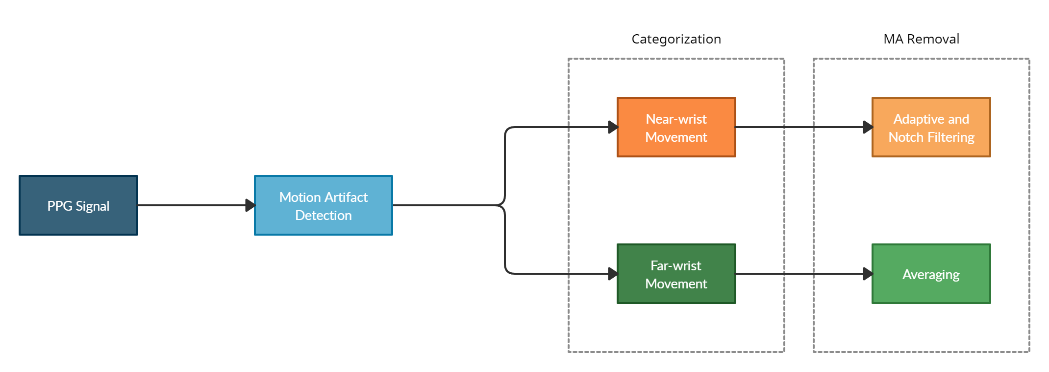
Our Approach

Slide 20
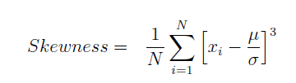
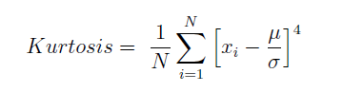
Detection
Skewness
Kurtosis

Slide 21
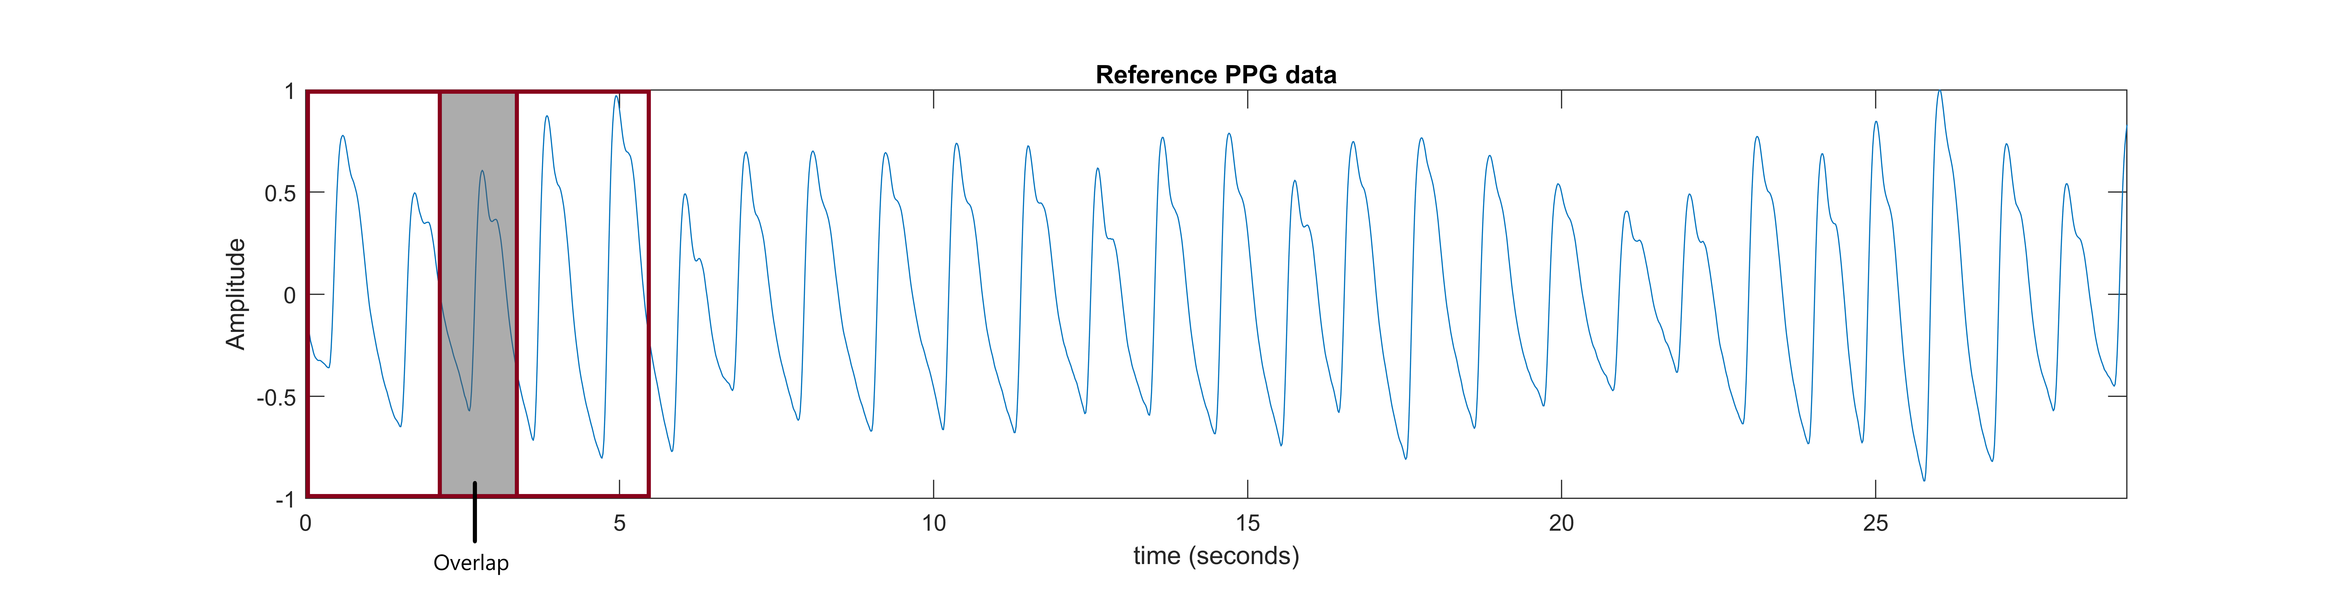
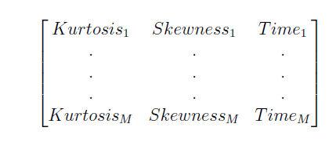
Calibration

Slide 22
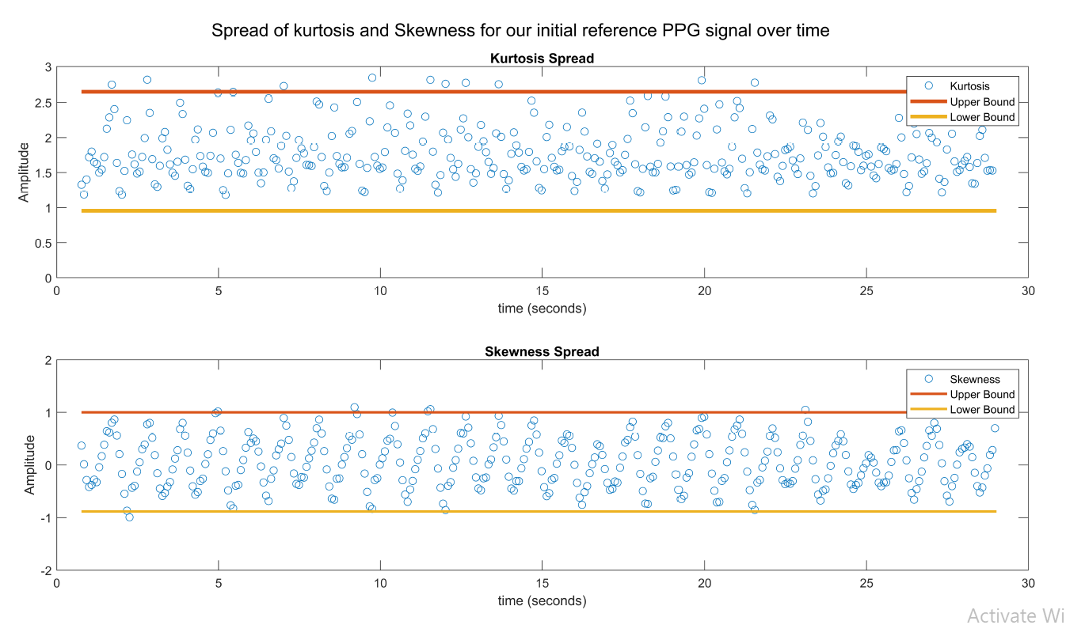

Slide 23
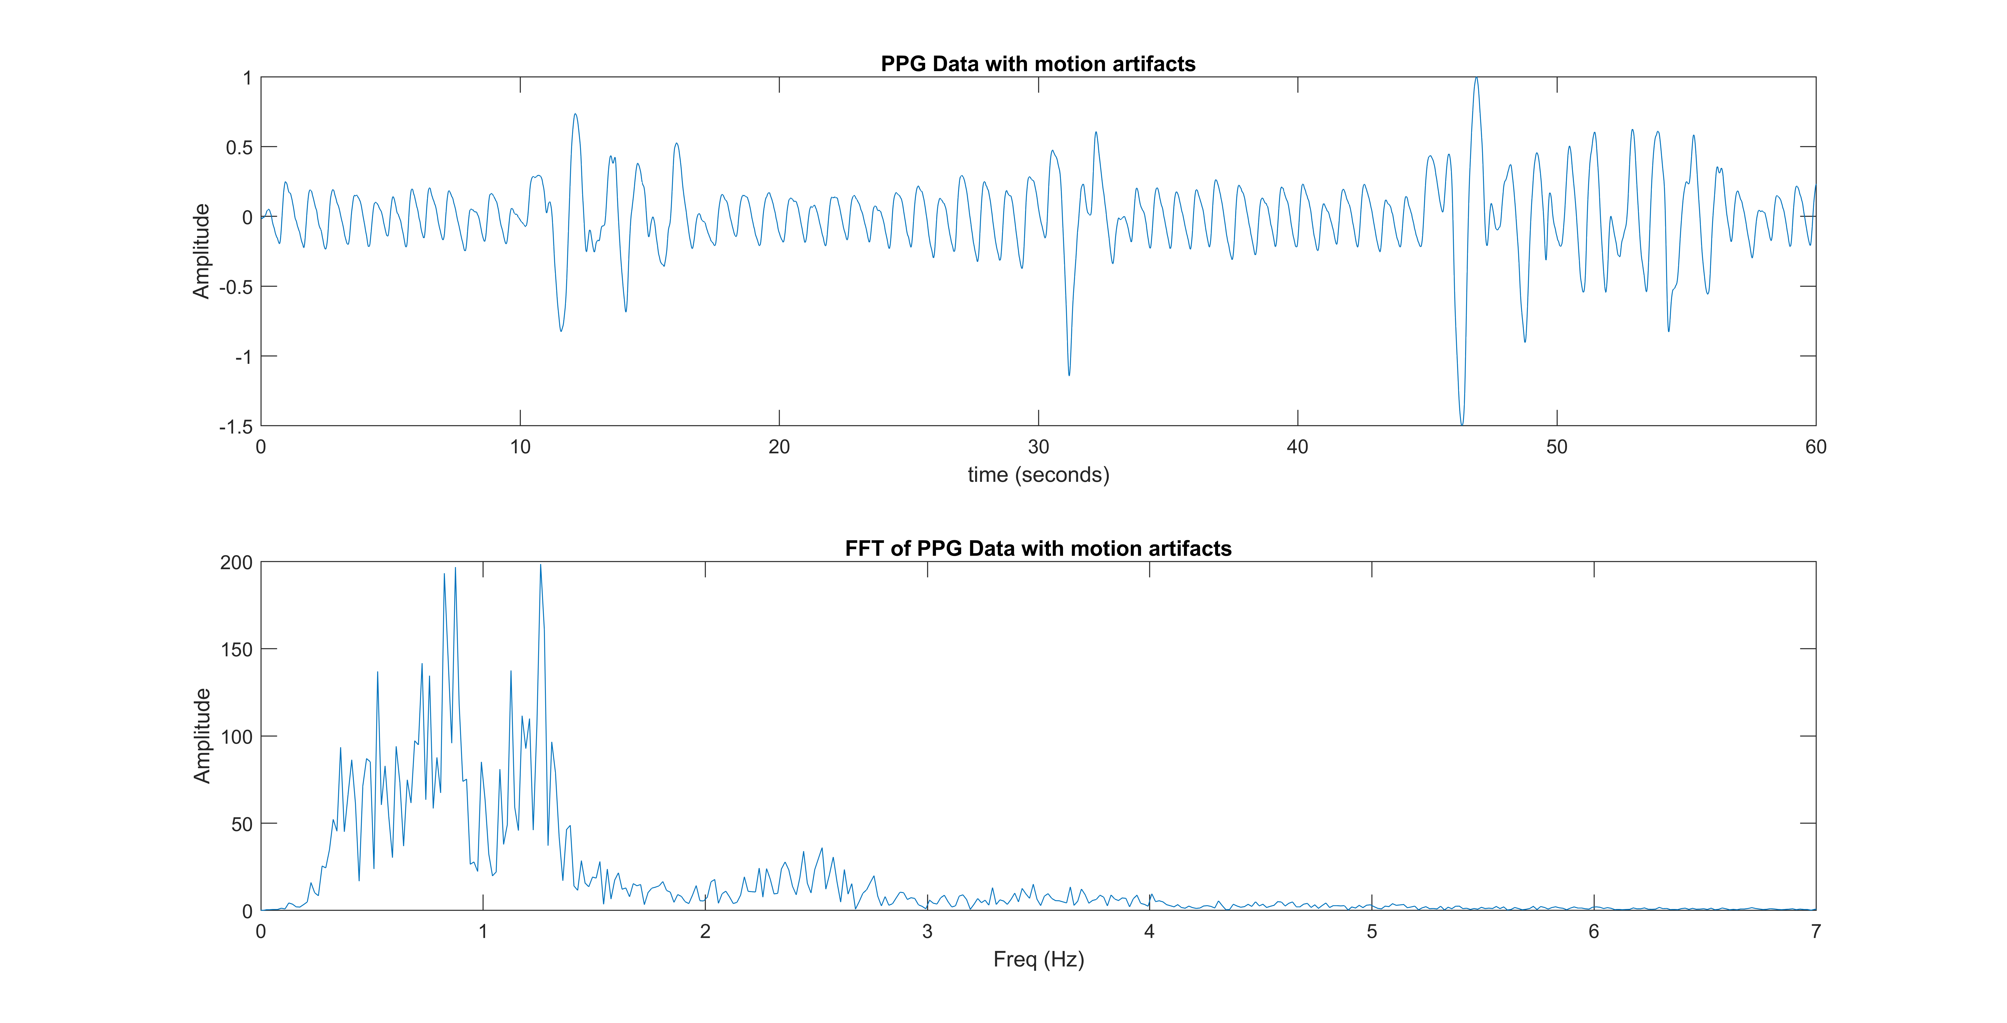
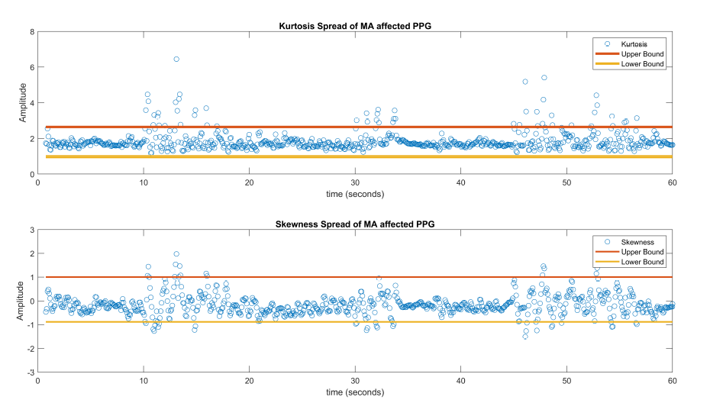
Windows

Slide 24
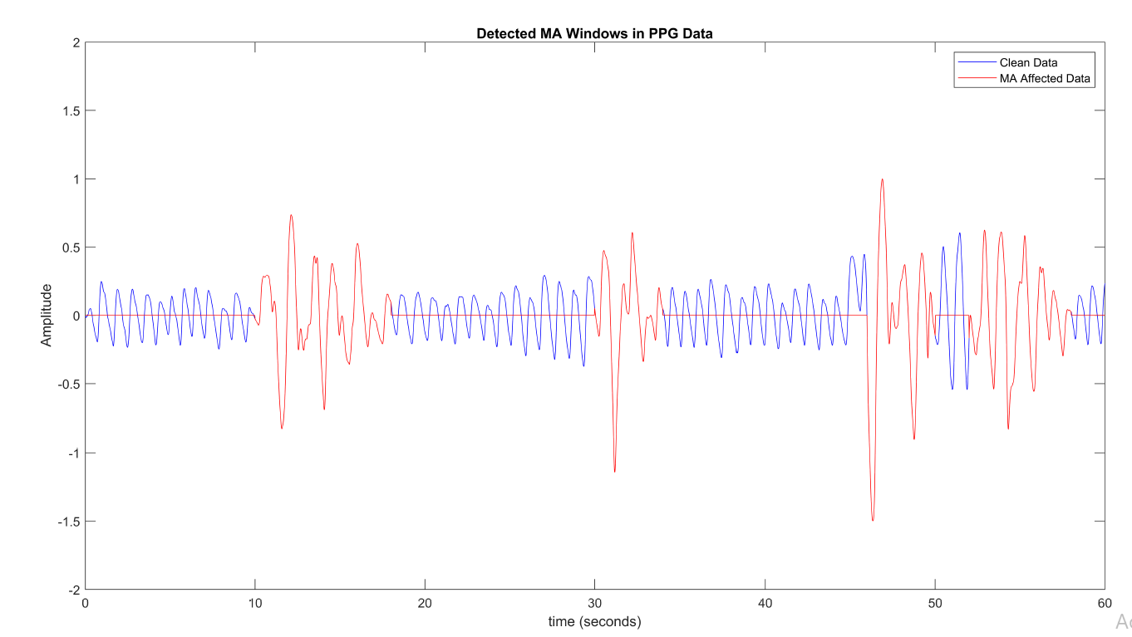
Classification
Far-Wrist Motion
Near-Wrist Motion

Slide 25
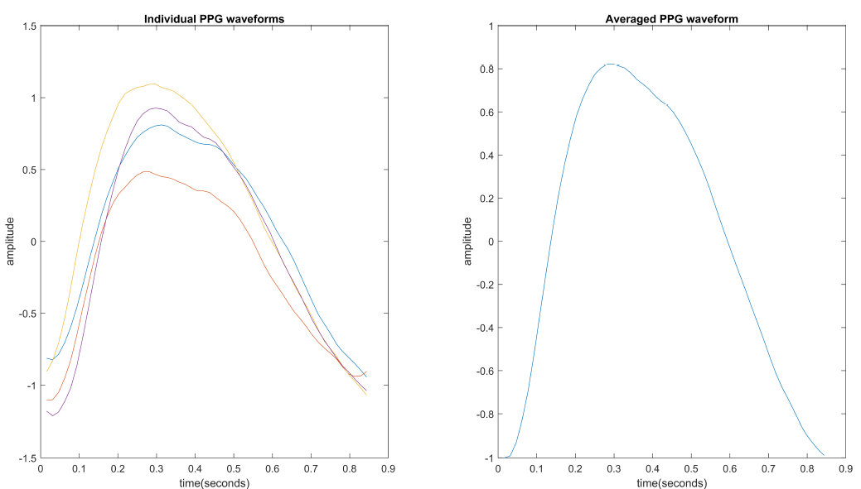
Far Wrist
Synthetic PPG segment based on average of PPG waveform from previously available data

Slide 26
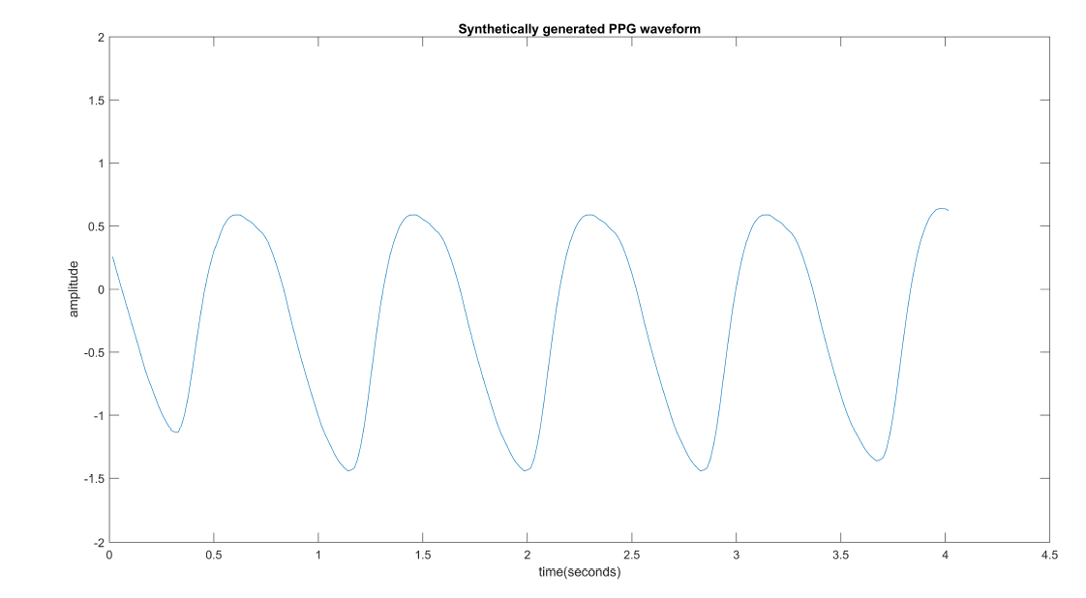

Slide 27
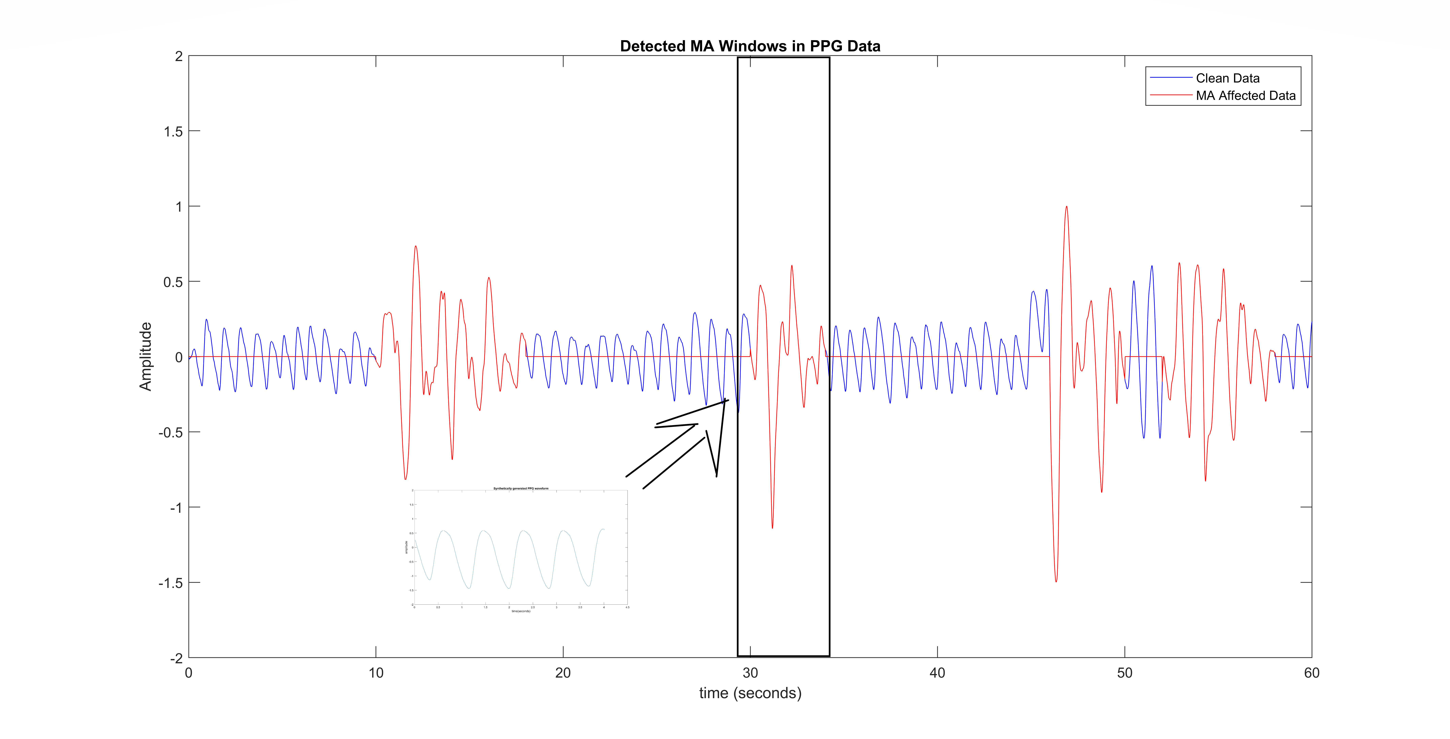

Slide 28
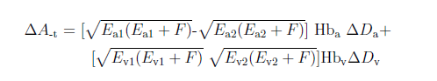
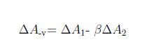
Near Wrist
Tissue Effect
Venous Blood Movement
Remove using Adaptive and Notch filtering

Slide 29
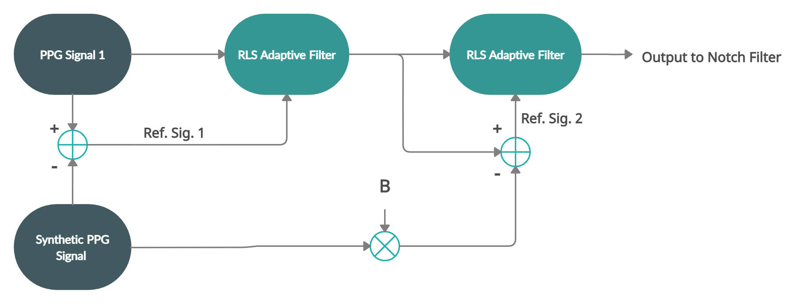
Adaptive filtering

Slide 30
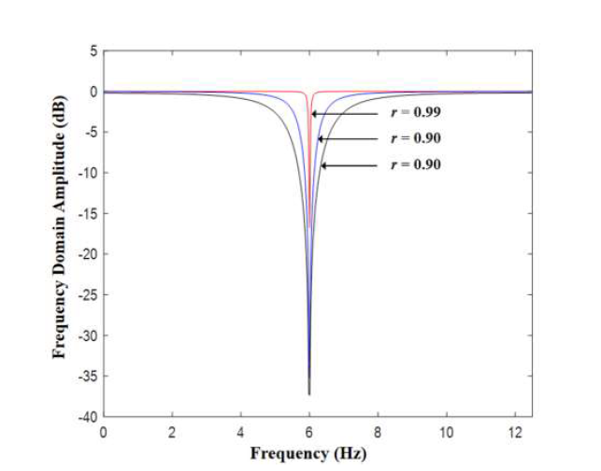
Notch filtering
PPG signal is quasi-periodic
Spectral components around heart rate frequency (HRF) and its harmonics
Suppresses signal around notch frequency and leaves other frequencies as is
Frequency Domain Amplitude Response of a Notch Filter [5]

Slide 31
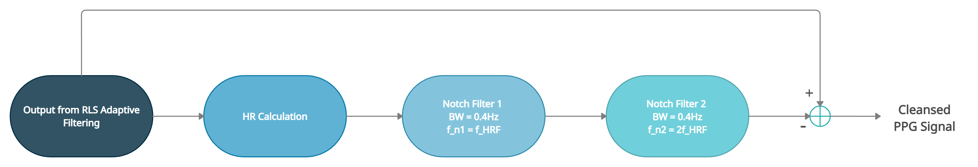
Notch filtering - Continued

Slide 32
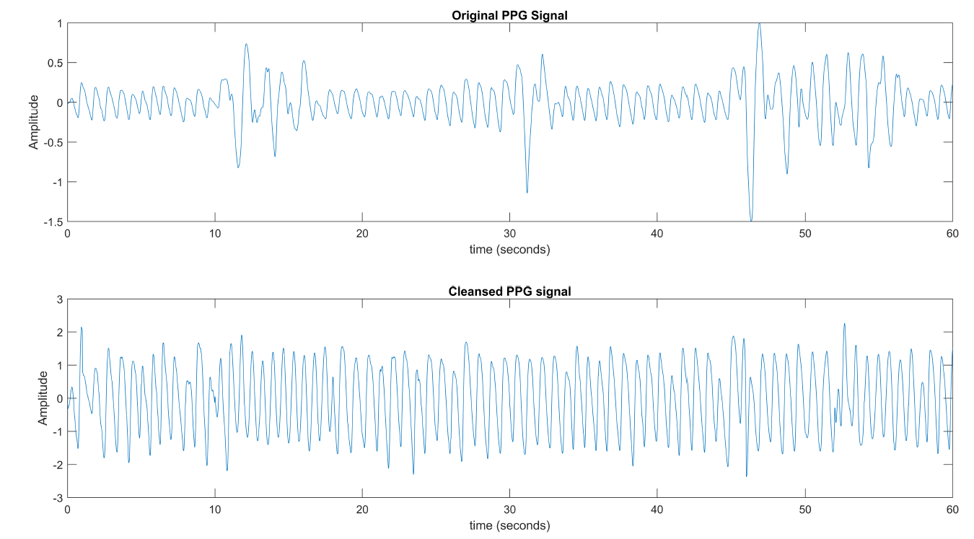
Before vs After

Slide 33
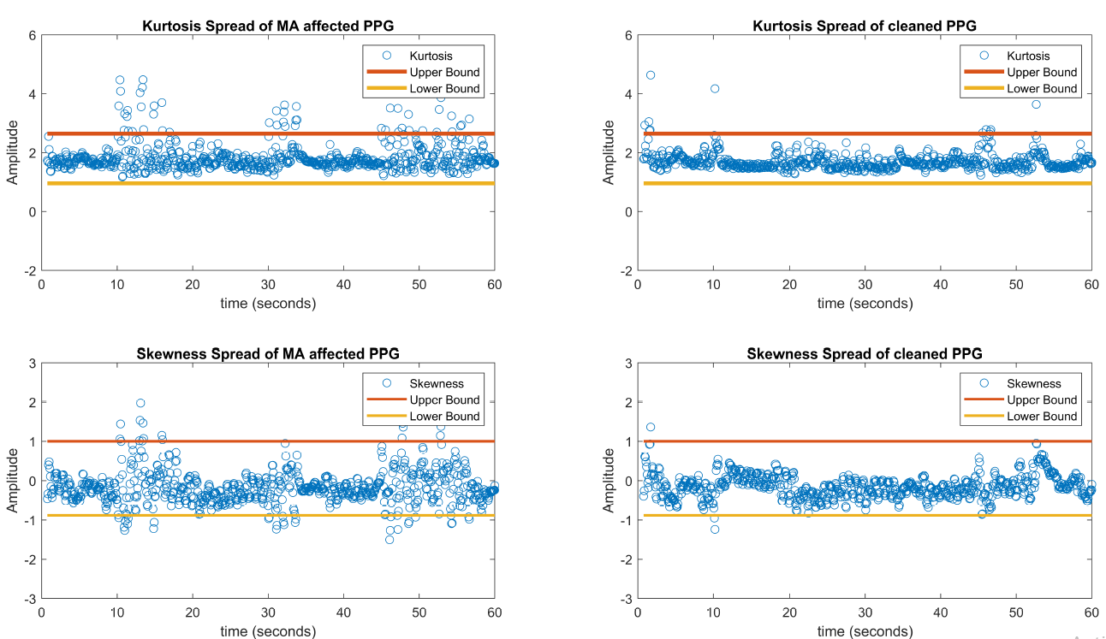

Slide 34
Experimentation and Results

Slide 35
Setup
8 Subjects:
Rest (reference signal)
Exercise 1 : Walking
Exercise 2 : Slight arm movement
Exercise 3 : Typing
Exercise 4 : Writing

Slide 36
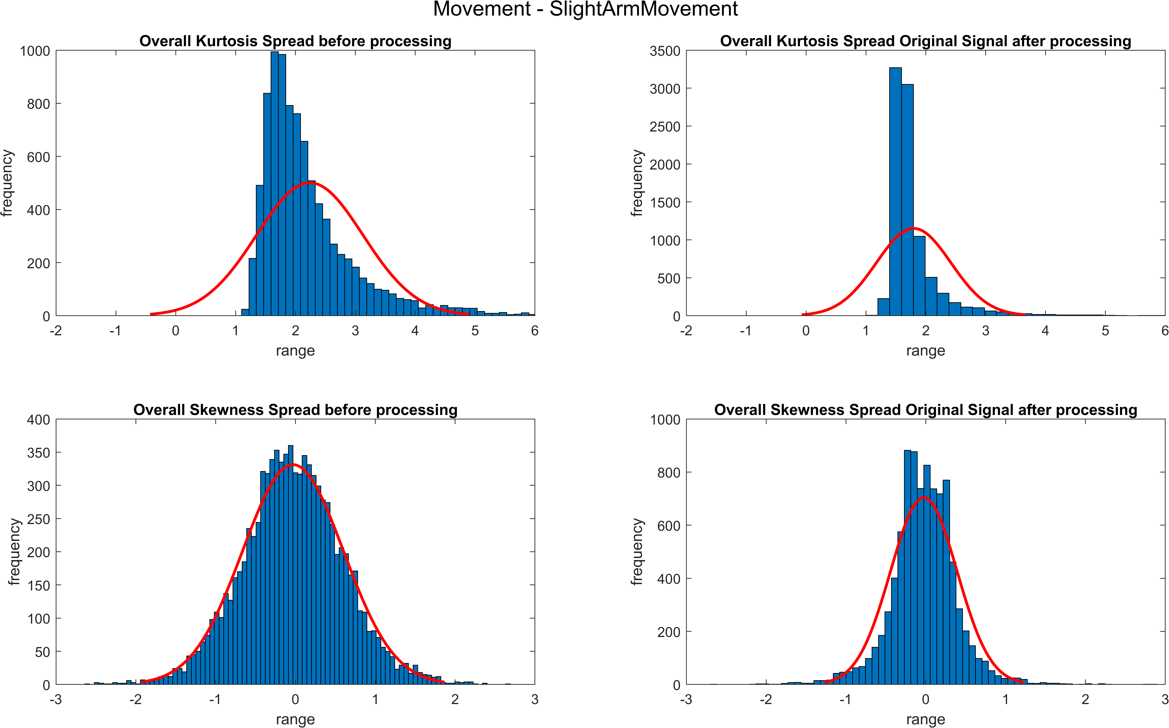
Results

Slide 37
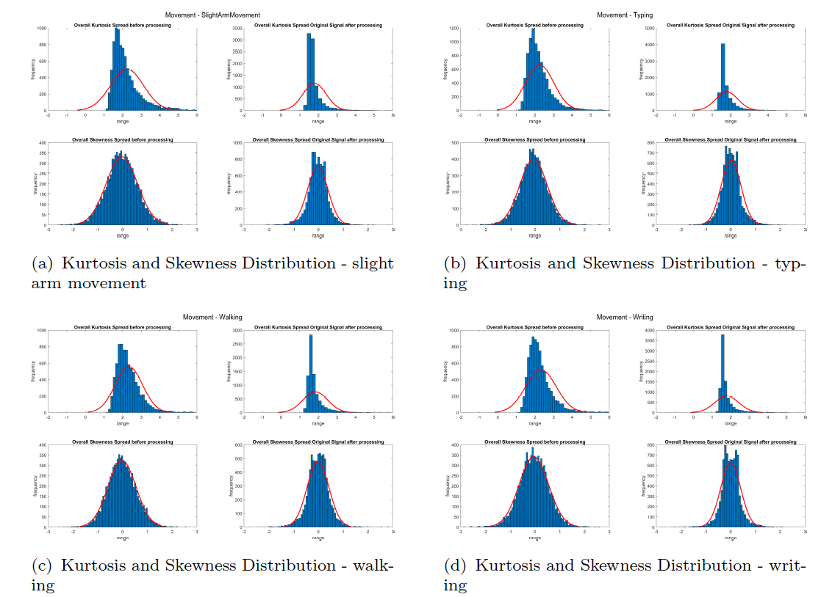

Slide 38
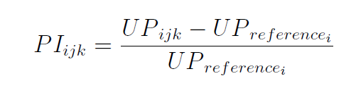
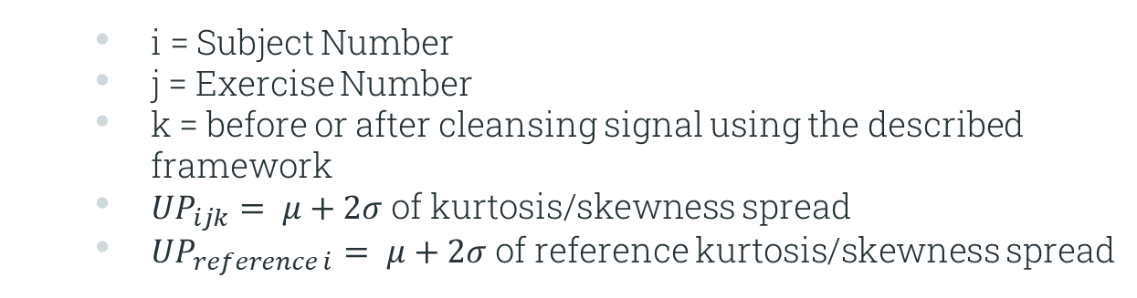
Performance Index
i = Subject Number
j = Exercise Number
k = before or after cleansing signal using the described framework
${UP}_{ijk}= μ+2σ$ of kurtosis/skewness spread
${UP}_{reference i}= μ+2σ$ of reference kurtosis/skewness spread

Slide 39
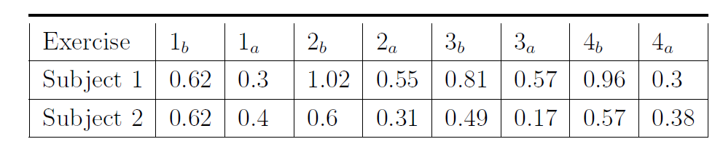
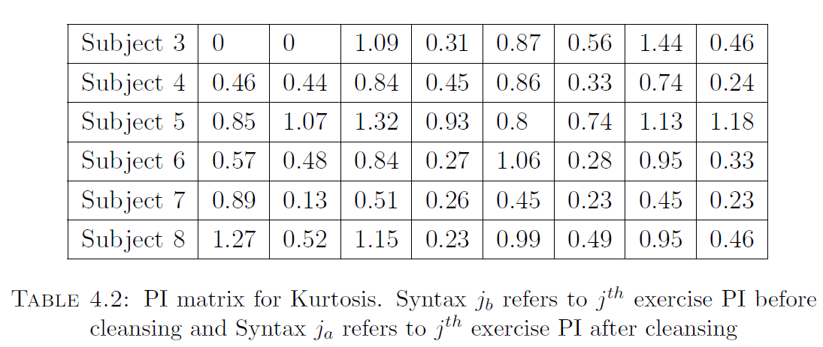
PI Matrix - Kurtosis

Slide 40
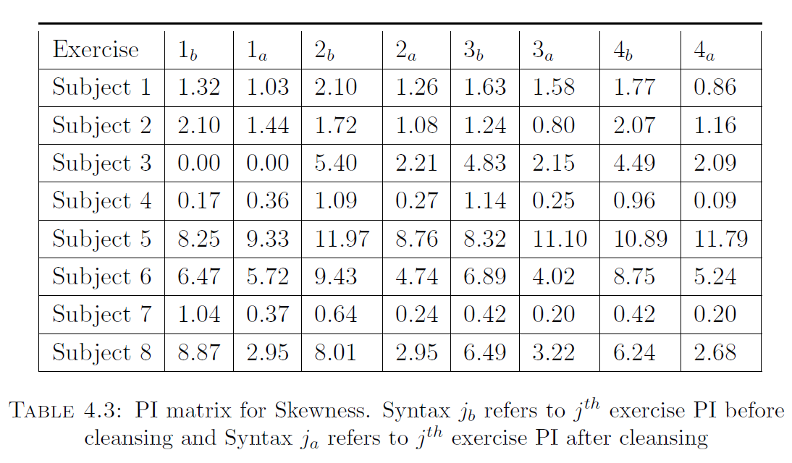
PI Matrix - Skewness

Slide 41
Limitations
Accuracy limited with severe motion artifacts over long periods
Synthetic PPG signal relies on quality of previous PPG segment
Requirement of reference signal

Slide 42
Benefits
Optimized efficiency
Computational complexity reduced
Retains PPG waveform
Live simulation

Slide 43
Future Work

Slide 44
Future Recommendations
Collect more data
Overcome limitations of synthetic data
Develop online system
Hardware implementation
Detection of cardiac conditions and health parameters

Slide 45
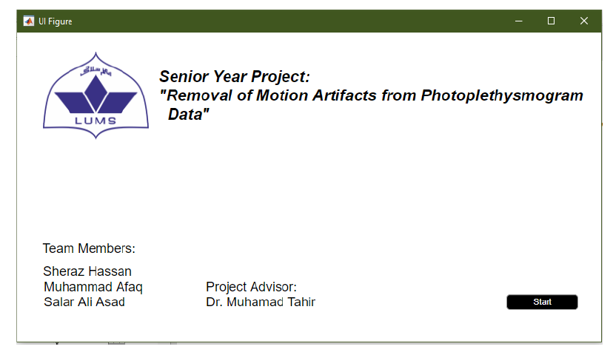
Graphical User Interface (GUI)

Slide 46
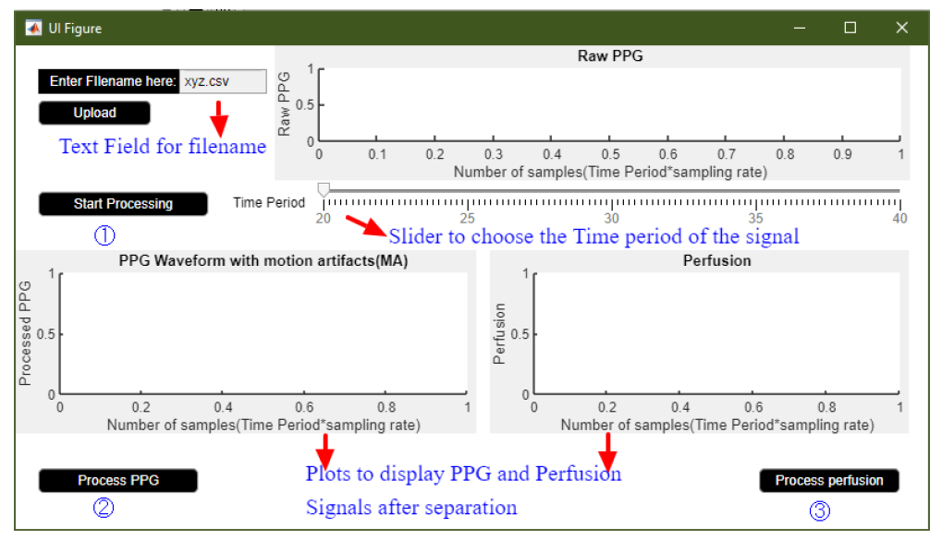

Slide 47
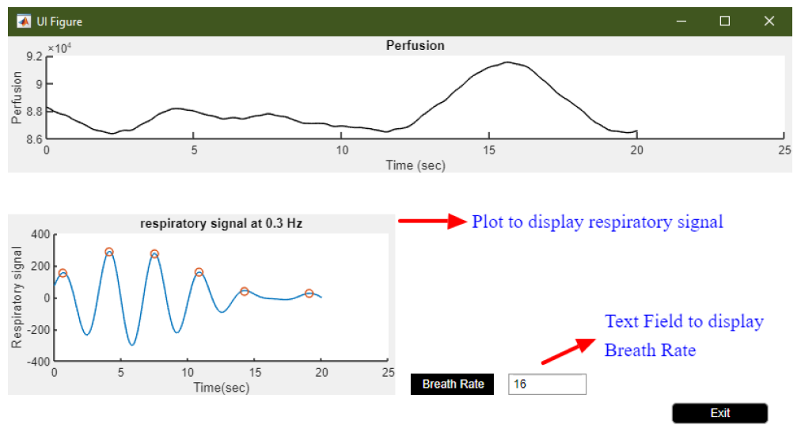

Slide 48
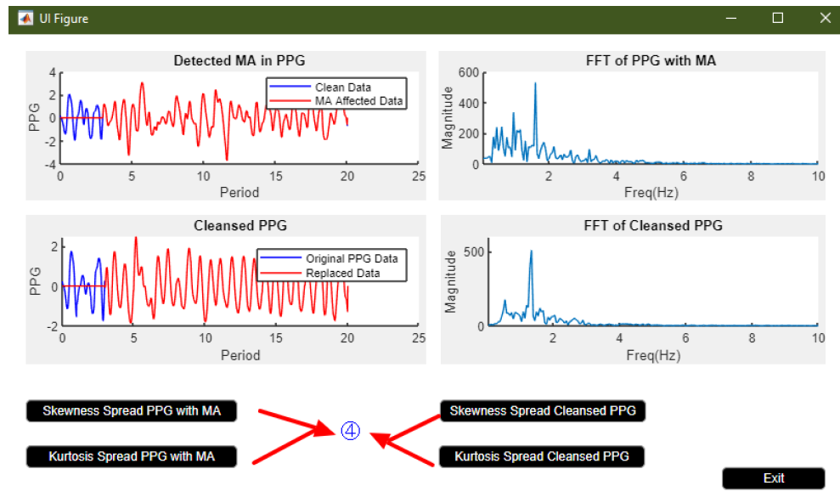

Slide 49
Thank You!
Any questions?

Slide 50
References
[1] S. Naseem, U. K. Khattak, H. Ghazanfar, and A. Irfan, \Prevalence of noncommunicable diseases and their risk factors at a semi-urban community, Pakistan," Pan Afr Med J, vol. 23, p. 151, 2016.
[2] S. Lee, G. Ha, D. Wright, Y. Ma, E. Sen-Gupta, N. Haubrich, P. Branche, W. Li, G. Huppert, M. Johnson, B. Mutlu, K. Li, N. Sheth, J. Wright, y.-s. Huang, M. Mansour, J. Rogers, and R. Ghaari, \Highly exible, wearable, and disposable cardiac biosensors for remote and ambulatory monitoring,“ npj Digital Medicine, vol. 1, 12 2018.
[3] C. Fischer, M. Glos, T. Penzel, and I. Fietze, \Extended algorithm for realtime pulse waveform segmentation and artifact detection in photoplethysmograms,“ Somnologie, vol. 21, pp. 1-11, 05 2017.
[4] Charlton P.H., Villarroel M., Salguiero F. (2016) Waveform Analysis to Estimate Respiratory Rate. In: Secondary Analysis of Electronic Health Records. Springer, Cham. https://doi.org/10.1007/978-3-319-43742-2_26
[5] Wang, Min; Li, Zhe; Zhang, Qirui; Wang, Guoxing. 2019. "Removal of Motion Artifacts in Photoplethysmograph Sensors during Intensive Exercise for Accurate Heart Rate Calculation Based on Frequency Estimation and Notch Filtering" Sensors 19, no. 15: 3312. https://doi.org/10.3390/s19153312

